Slide 1
A case study of social robotics addressed to students with autism in upper secondary school
Ivan Traina, PhD
Department of Human Sciences - University of Verona, Italy

Slide 2
Introduction
This presentation describes a case study on the use of social robotics for students with Autism Spectrum Disorder (ASD) in upper secondary school.
The case study focused on an intervention carried out in 2020-22 and aimed at promoting an inclusive educational-school context through assistive technology.
Institutions involved:
Verona Autism Desk
Regional school support center
Department of Human Sciences – University of Verona
Hospital of Verona – Neuropsychiatric Unit
N. 5 upper secondary schools located in Verona province

Slide 3
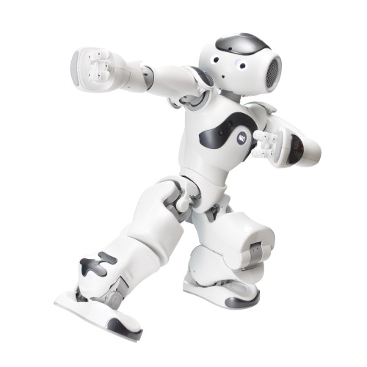
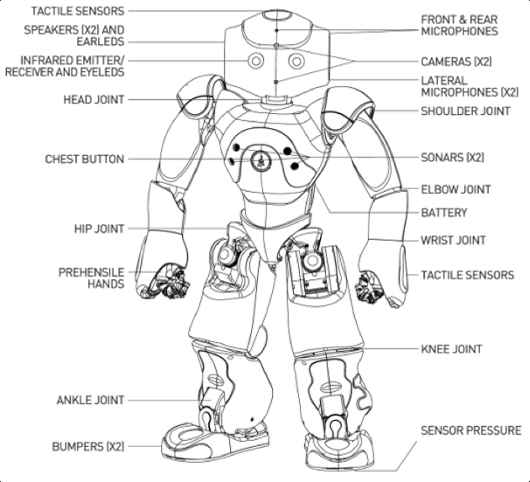
NAO social robot
To respond the needs expressed by institutions involved in the intervention, it was decided to use the NAO social robot.

Slide 4
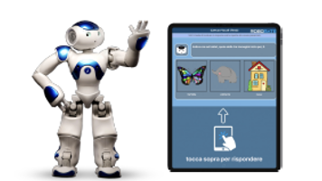
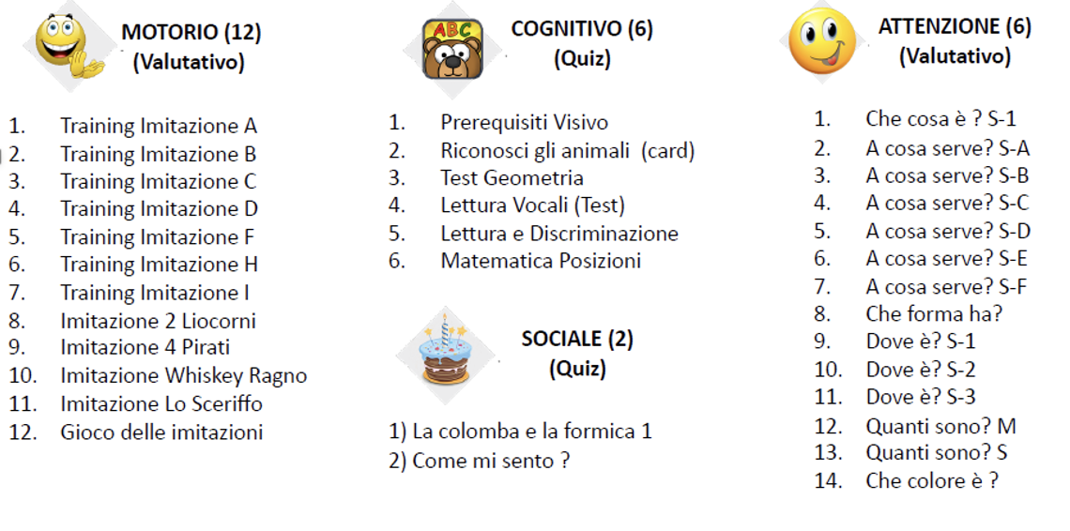
Method used with robots
The method adopted for using the robot is based on the A-RAT methodology (Autonomous Robot Assisted Teaching), that allow students to interact with robot through tablet for responding to instructions.

Slide 5
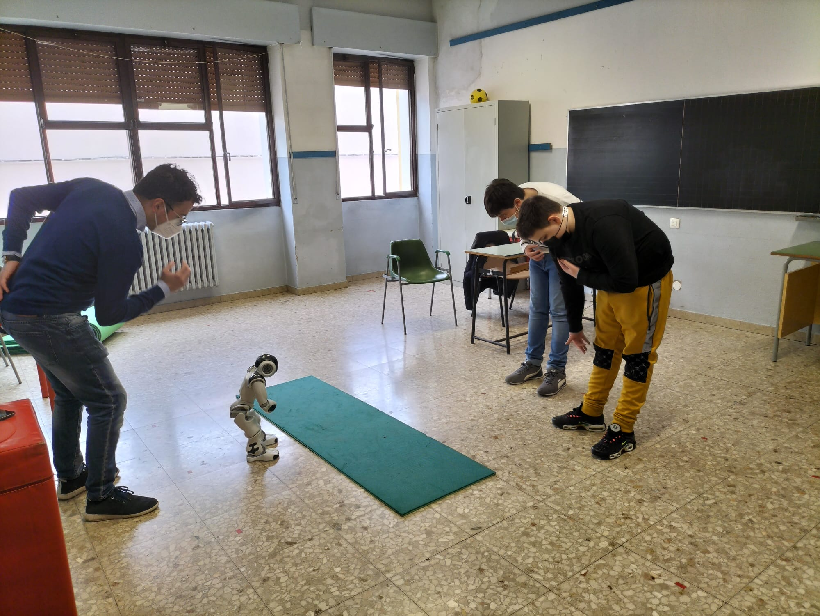
Objectives of the intervention
Improvement of:
attention
communication
imitation
social behavior
interactions
Investigate the level of accessibility of social robot in terms of usability, both for students and support teachers involved.

Slide 6
Research questions
What are the requirements for a correct introduction of social robots in educational contexts?
What modality could be adopted for using social robots within individualized teaching proposals?
Which learning and socialization needs of students with ASD can be addressed by social robots?

Slide 7
Case study methodology and tools
Qualitative approach, that through naturalistic observations allowed to collect information on changes emerged following the intervention.
Thematic analysis of the experiences of students with ASD and support teachers involved.
Compilation of logbooks and feedback collection through focus groups with support teachers.
These allowed to analyze qualitative data from participants for understanding the level of acceptability and replicability of intervention.

Slide 8
Support team
Members:
computer technician
pedagogist
neuropsychiatrist
researcher
support teacher coordinator
The purposes:
provide guidance to support teachers (n. 10) of schools involved
identification of education tasks
definition of exercises consistent with student's educational objectives
training on programming and maintenance of robots
support in updating the Individualized Education Plan (IEP) of students involved

Slide 9
Participants
The profiling of participants (students with ASD) was carried out to identify a set of initial skills that could change over time and contribute to the definition of objectives and learning activities.
Participants’ selection criteria:
diagnosis of ASD
possibility of representing different classes/levels of the secondary school cycle
different levels of ASD

Slide 10
Activities proposed
The activities proposed consisted of the following steps:
exposition of the topic through the robot
presentation of some quizzes with the possibility of viewing 4 types of answers on the tablet or on robot's display
data collected by the robot: acquisition of answers (right or wrong), detection of response time, execution of the exercise and number of attempts

Slide 11
Examples of exercises
The exercises were elaborated considering the objectives identified on an ICF basis and those included in the IEP.
Examples:
The robot asks "How are you?", for improving communication skills
The robot asks "What is it for?», for strenghting attention ability
The robot presents a Social story, for encouraging imitation, social behaviors and interaction

Slide 12
Results emerged from case study
The possibility to settle a collaborative context.
The opportunity to be supported by a team of experts to design individualized learning activities for the acquisition of specific skills such as attention, communication, imitation as well as social behaviours.

Slide 13
Discussion
The results achieved allowed to understand:
The importance to adopt social robots within individualized teaching proposals, strongly correlated to student’s needs.
The usefulness to define the functioning profile of students before selecting the activities to carry out with robots.
The opportunity to anchor the activities implemented with robots to what is outlined in the Individualized Education Plan (IEP).
The fundamental role of support teacher as mediator between school, family, and support services.

Slide 14
Conclusions
Attention, communication, and social behaviors skills are needs that can be effectively addressed using social robots.
Usefulness to define the functioning profile of participants.
Anchor the activities delivered by the robots to what is outlined in the IEP.
The collaboration of different institutions and experts facilitate the introduction of social robots in the education environment.

Slide 15
References
World Health Organization. (2022). Global report on assistive technology. Available from:
https://www.who.int/publications/i/item/9789240049451
Pennisi, P., Tonacci, A., Tartarisco, G., Billeci, L., Ruta, L., Gangemi, S., & Pioggia, G. (2016). Autism and social robotics: A systematic review. Autism Research, 9(2), 165-183. Available from:
https://pubmed.ncbi.nlm.nih.gov/26483270/
Scassellati, B., Boccanfuso, L., Huang, C. M., Mademtzi, M., Qin, M., Salomons, N., ... & Shic, F. (2018). Improving social skills in children with ASD using a long-term, in-home social robot. Science Robotics, 3(21), eaat7544. Available from:
https://pubmed.ncbi.nlm.nih.gov/33141724/
Marino, F., Chilà, P., Sfrazzetto, S. T., Carrozza, C., Crimi, I., Failla, C., ... & Pioggia, G. (2020). Outcomes of a robot-assisted social-emotional understanding intervention for young children with autism spectrum disorders. Journal of autism and developmental disorders, 50, 1973-1987. Available from:
https://pubmed.ncbi.nlm.nih.gov/30852783/
Duradoni, M., Colombini, G., Russo, P. A., & Guazzini, A. (2021). Robotic psychology: a PRISMA systematic review on social-robot-based interventions in psychological domains. J, 4(4), 664-697. Available from:
https://www.mdpi.com/2571-8800/4/4/48
Morgan, S. J., Pullon, S. R., Macdonald, L. M., McKinlay, E. M., & Gray, B. V. (2017). Case study observational research: A framework for conducting case study research where observation data are the focus. Qualitative health research, 27(7), p. 1060-1068. Available from:
https://pubmed.ncbi.nlm.nih.gov/27217290/
Braun, V., & Clarke, V. (2006). Using thematic analysis in psychology. Qualitative Research in Psychology, 3(2), 77–101. Available from:
https://www.tandfonline.com/doi/abs/10.1191/1478088706qp063oa

Slide 16
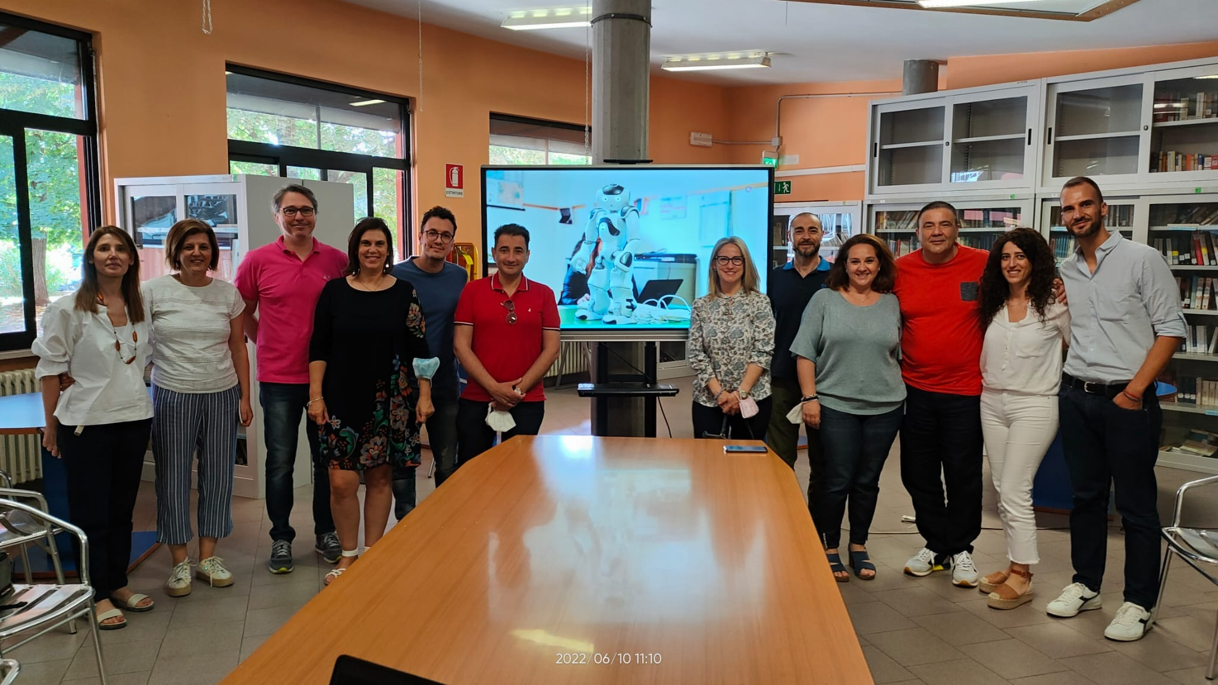
Thanks for your attention!
ivan.traina@univr.it

